Slide 1
Sign-In!!!
signin.rvapt.ritsec.club

Slide 2
RVAPT - 1
Pre-Engagement

Slide 3

Semester Plan
Focus on Penetration Testing
PTES - Penetration Testing Execution Standard
Penetration Testing 7 steps
Modified version
Presentation
Tool talks
Side Project talks
Live Demos (?)
Notes:
Pre-engagement, Recon, Threat modeling(no), Vulnerability analysis, Exploitation, Post-exploitation, Reporting
Mohad from here

Slide 4
Offensive Security
Types | Vulnerability Assessment | External Penetration Testing | Internal Penetration Testing | Red Teaming
Goal | Identify → Assess → Remediate → Monitor | Security audit on client’s network (consulting) | Security audit on company infrastructure/ products | Real world attack simulation
Duration | Short | Varies - 1~2 weeks | Varies - 1~2 weeks | 2~3 months
MISC | Automatic + Manual checking, Bug Bounty | Usually black-box, Limited Scope, Restrictive, SE sometimes allowed | Usually white-box, Limited Scope, Usually testing new products/features, SE not allowed | (Almost) No rules, Defense Evasion

Slide 5
Types of Penetration Testing
Penetration Testing
External Network
Internal Network
Physical
Application
Wireless
*
Social Engineering

Slide 6
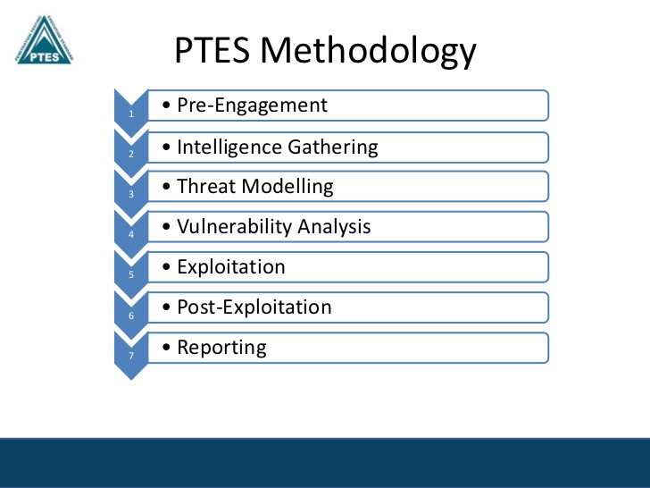
Table of Contents
What is Pre-Engagement
Request for Proposal
Request for Information
Statement of Work
Rules of Engagement
Scope & Point of Contact
Case Study 1: CPTC
Case Study 2: Coalfire

Slide 7

Penetration Testing

Slide 8
What is Pre-Engagement
Interaction between the client and service provider prior penetration testing engagement
Documents, meetings, phone calls
Purpose
Establish exact terms
Setup expectations, purpose, overview of engagement
Request for Proposals
Define Scope
Define Rules of Engagement
(Give jobs to corporate lawyers)
Legal documents
Get out of jail!

Slide 9
Why Should I Care?
Basis of all our work
(Some companies) You are the Offsec department
Being on the same page
Testers
Clients
PMs
Planning for the future

Slide 10
Pre-Engagement Documents
Request for Proposal (RFP)
Client: Does anyone want to do this work for me?
Response to Proposal
SP: Sure. Pick me!
Request for Information (RFI)
SP: Requesting specific information regarding target
Statement of Work (SoW)
SP: Project details, $$$, Operator information, Deliverables, Timeline, etc
Rules of Engagement (RoE)
Client+SP: You can do this. Don’t do that.
Get of the Jail Free Card
Client+SP: Help it’s the policeman

Slide 11
Request & Response for Proposal
Request for Proposal
Client: “Hey, does anyone want to do a penetration testing for us?”
Overview, Purpose, Scope of work, Timeline, Point of Contact
Service Provider: “Pick me!!!”
Response to Proposal
Overview
Team Cred - Flex
Assessment Plan
[Caution] Vague Wording

Slide 12
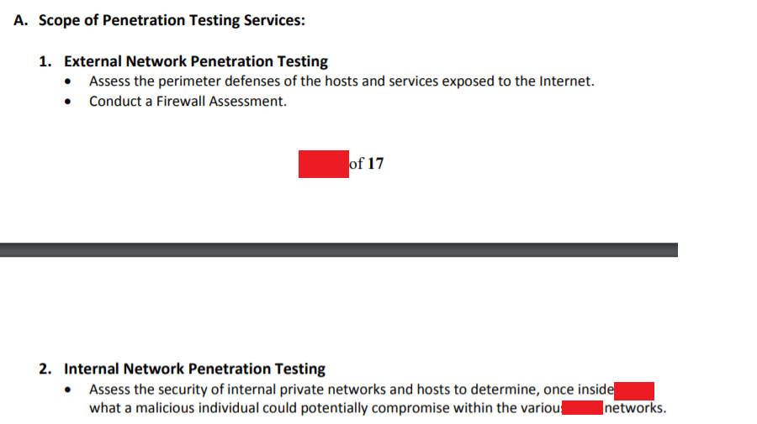
??? - I need at least some details

Slide 13
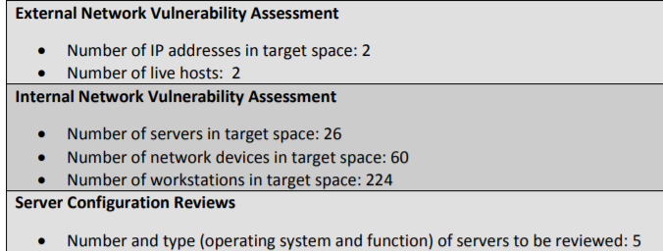
Ah, that’s more clear

Slide 14

Request for Information
Gimme more details
Network
Hosts managed by 3rd party?
# of subnets?
# of hosts?
Hands off - Network services?
Application
URL / Destination of the application?
3rd party (Reverse Proxy, Cloud provider) aware?
Account lockout policy?
Allow list / Deny list IP address?
PII handling?
MISC
Compliance?
Laws?

Slide 15

RFI Demo
Engagement with a multinational bank - DinoBank
Application Penetration Testing
Main Banking web application
Viewing accounts
Paying & Transferring
Etc.
Come up with at least one question for RFI to ask to your client

Slide 16
Statement of Work
Let’s talk business
Service Overview
Pricing
Deliverables
Tester Information
Timelines and Schedules
Payment terms, Disclaimers, Legal things

Slide 17
Rules of Engagement
Identify and define
Project Description and Purpose
Scope (Target systems)
Testing Methodology
Logistics
Planning, Schedule, Assumptions, Reporting
Technical Restrictions / Rules
Notification + Disclosure + Point of Contact
Request for Information to client
What is allowed + Not allowed
Etc. - Social engineering limits, Physical assessment boundaries,

Slide 18

Scope
Targets
Servers
Applications
Hardware (networking, firewall, ATM)
Frameworks
Physical
Configurations
OUT OF SCOPE IS LAVA
Define clear scope → Ask!

Slide 19
Point of Contact
Clearing things up
Asking for permission
Exploitation
Scope
Notifying changes in network
During engagement check up
Usually separate Technical and Administrative Contact
Notes:
Choi

Slide 20

Get Out of Jail Free Card
Penetration Testing Authorization
Date, Client, Operator, Point of Contact
This is what we are going to do
This is what we are not allowed to do
Agreed?
Used for Physical Penetration Testing
Legal Document

Slide 21
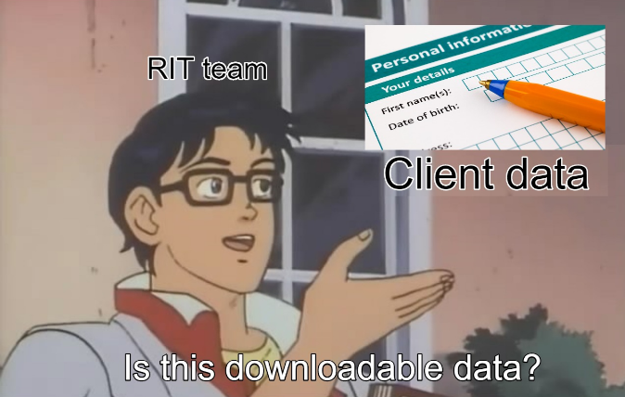
Case Study 1 - CPTC

Slide 22
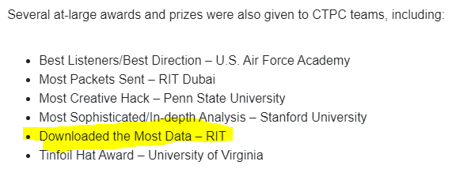
Case Study 1 - CPTC

Slide 23
Case Study 1 - CPTC
[REDACTED]

Slide 24
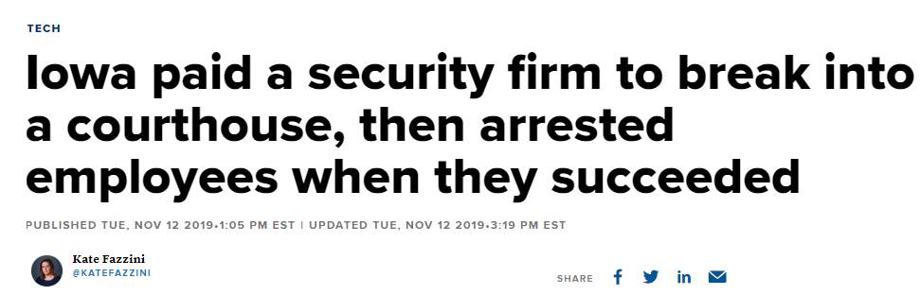
Case Study 2 - Coalfire
CNBC

Slide 25
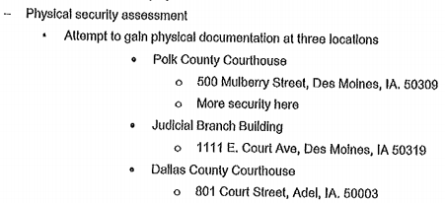
Case Study 2 - Coalfire
Contract = Coalfire + State of Iowa
Target = Iowa County Courthouse
State vs. County - Different Entity
Set off alarm to test physical assessment
Police → Get off jail card → Let go
Sheriff (County) → Arrest
Miscommunication between State and County
Pre-Engagement document was clear
Laws / Power dynamics is complicated. Always double check!

Slide 26
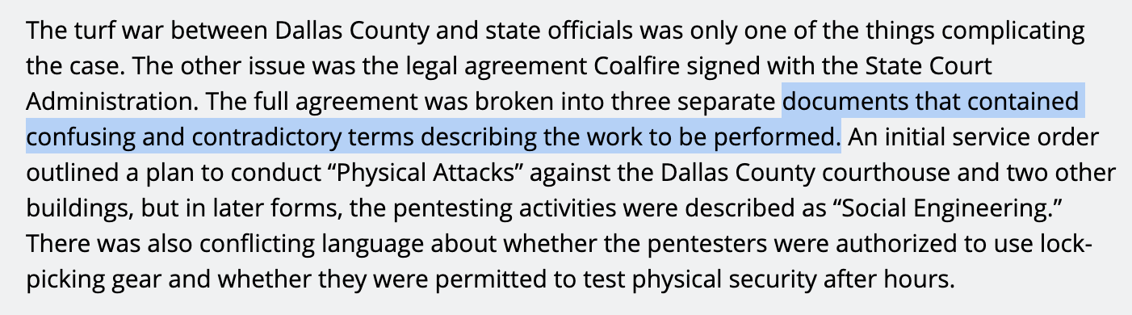
Case Study 2 - Coalfire - Cont.
Devil is in the Details!!!!!!

Slide 27
References
PenTest Guidance - https://www.fedramp.gov/assets/resources/documents/CSP_Penetration_Test_Guidance.pdf
RFP - https://www.ctpf.org/sites/main/files/file-attachments/external_and_internal_penetration_testing_services_rfp.pdf
RFP2 - http://www.oaklawn-il.gov/home/showdocument?id=10954
Coalfire RoE - https://cdn.arstechnica.net/wp-content/uploads/2019/11/rules-of-engagement.pdf

Slide 28
Question the Document

Slide 29
Technical Assessment
https://www.hackthebox.eu/

